Slide 1
graph basic

Slide 2
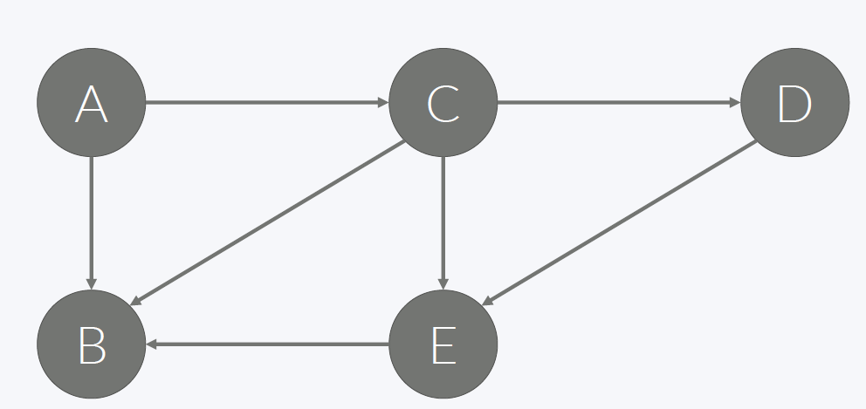
Path, Cycle
Path
Cycle
A→C→D→E→B
A→B
A→C→B
A→C→E→B
A→C→B →A
A→C→E→B→A
A→C→D→E→B→A

Slide 3
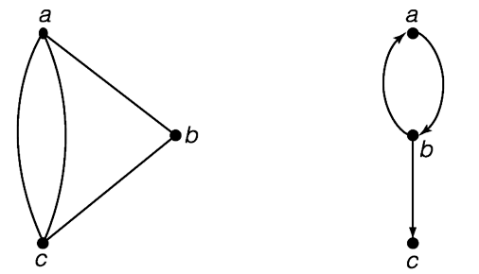
Directed, Undirected Graph
A graph is a non-empty finite set V of elements called vertices together with a possibly empty set E of pairs of vertices called edges.
Undirected Graph
Bidirection Graph
directed Graph

Slide 4

Representation of graph
1.
G＝(V, E)
V＝{v1, v2, v3, v4, v5}
E＝{e1, e2, e3, e4, e5, e6, e7, e8 }
＝ {(v1, v2), (v1, v3), (v1, v4), (v2, v3),
(v2, v5), (v3, v4), (v3, v5),(v4, v5) }
2. Multiple Edges
G＝(V, E),
V＝{1, 2, 3, 4, }
E＝{(1, 2),(1, 3),(1, 4),(2, 3),(2, 3),(3, 4),(3, 4),(3, 4)}

Slide 5
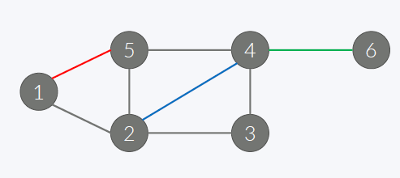
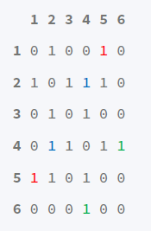
Representation of graph(unweighted)
V = {1, 2, 3, 4, 5, 6}
E = {(1,2), (1,5), (2,5), (2,3), (3,4), (2,4), (4,5), (4,6)}
6 8 //v= 6, E= 8
1 2
1 5
2 3
2 4
2 5
5 4
4 3
4 6

Slide 6
Representation of graph
6 8 //v= 6, E= 8
5
4
6
1
1 2
1 5
2 3
2 4
2 5
5 4
4 3
4 6
2
3
 | 0 | 1 | 2 | 3 | 4 | 5 | 6
0
1
2
3
4
5
6
MyMap = [[0]*7 for i in range(7)]
Data = list(map(int,input().split()))
for i in range(howmany):
Start= Data[i*2]
Stop = Data[i*2+1]
MyMap[Start][Stop] = 1
MyMap[Stop][Start] = 1
1
1
1
1
1
1
1
1
1
1
1
1
1
1
1
1

Slide 7
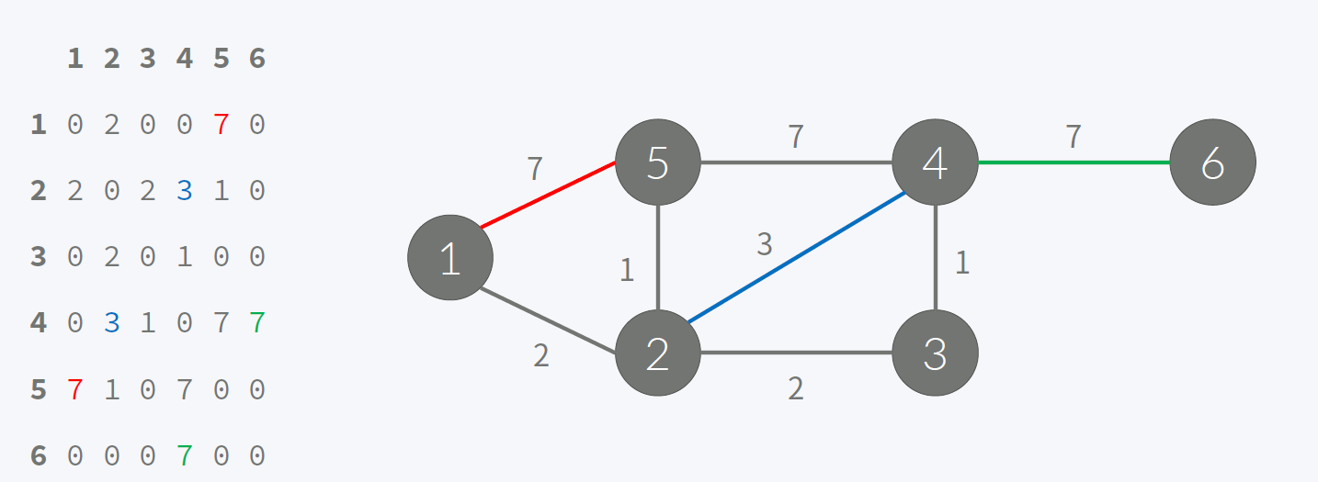
Representation of graph(weighted)
Map[start][stop] = Map[stop][start] = cost;

Slide 8
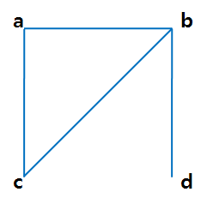
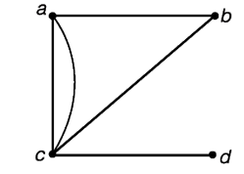
DeGree
deg(a) =
deg(b) =
deg(c) =
deg(d) =
deg(a) =
deg(b) =
deg(c) =
deg(d) =
The sum of degrees =
The sum of edges =

Slide 9
Degree : Undirected Graph
6 8 //v= 6, E= 8
1 2
5
4
6
1 5
2 3
2 4
1
2 5
5 4
2
3
4 3
4 6
Degree[Start] += 1
Degree[Stop]+=1
Degree
0 | 1 | 2 | 3 | 4 | 5 | 6
0 | 2 | 4 | 2 | 4 | 3 | 1
0 | 1 | 2 | 3 | 4 | 5 | 6
1
1
1
1
1
2
2
3

Slide 10
Degree : directed Graph
5
4
6
1
2
3
InDegree
0 | 1 | 2 | 3 | 4 | 5 | 6
0 | 0 | 1 | 1 | 3 | 2 | 1
OutDegree
0 | 1 | 2 | 3 | 4 | 5 | 6
0 | 2 | 3 | 1 | 1 | 1 | 0

Slide 11

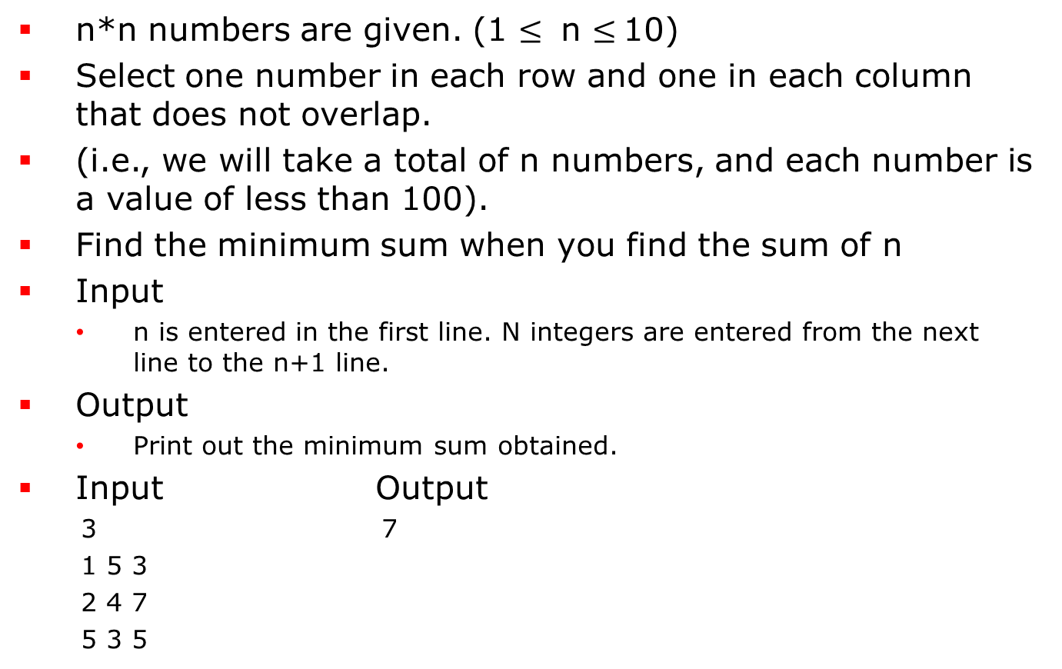
Exercise 1 Minimum Sum
n*n numbers are given. (1 $≤$ n $≤$10)
Select one number in each row and one in each column that does not overlap.
(i.e., we will take a total of n numbers, and each number is a value of less than 100).
Find the minimum sum when you find the sum of n
Input
n is entered in the first line. N integers are entered from the next line to the n+1 line.
Output
Print out the minimum sum obtained.
Input Output
3 7
1 5 3
2 4 7
5 3 5

Slide 12
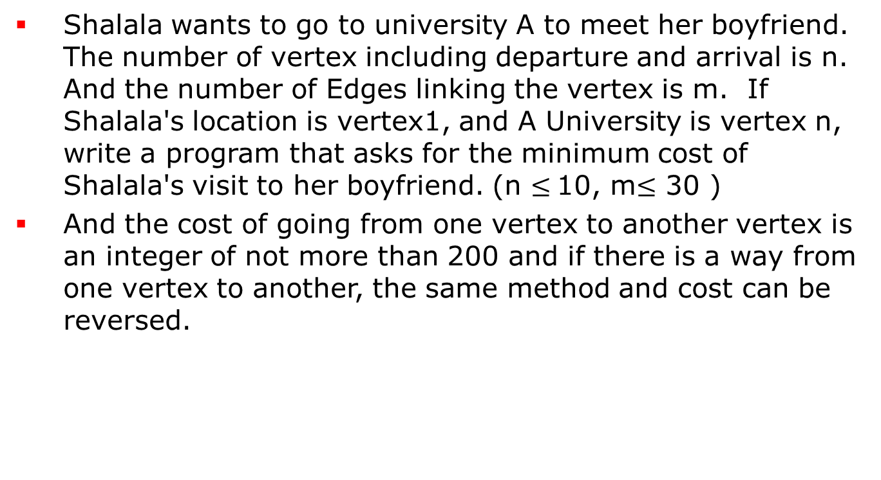
Exercise 2 On the way to meet the boyfriend
Shalala wants to go to university A to meet her boyfriend. The number of vertex including departure and arrival is n. And the number of Edges linking the vertex is m. If Shalala's location is vertex1, and A University is vertex n, write a program that asks for the minimum cost of Shalala's visit to her boyfriend. (n $≤$10, m$≤$ 30 )
And the cost of going from one vertex to another vertex is an integer of not more than 200 and if there is a way from one vertex to another, the same method and cost can be reversed.

Slide 13
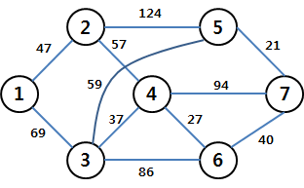
Exercise 2 On the way to meet the boyfriend
The following graph shows an example (there may be multiple edges to Vertex a-> Vertex b, There may be an edge going back to the same vertex.
Minimum Cost Path: 1→3→5→7,
Minimum Cost: 69+59+21=149

Slide 14
Exercise 2 On the way to meet the boyfriend
Input
In the first line, the number of vertices n and the number of edges m are entered, separated by spaces. The two vertices are numbered and weighted over the following line to m.
Output
print out the minimum cost of getting to the university. If not, print out "-1".
Input Output
7 11 149
1 2 47
1 3 69
2 4 57
2 5 124
3 4 37
3 5 59
3 6 86
4 6 27
4 7 94
5 7 21
6 7 40

